Slide 1
Survey of Dietary and Exercise Habits
https://forms.office.com/Pages/DesignPage.aspx?lang=pt-PT&origin=OfficeDotCom&route=Start&fsw=0#FormId=TB9FqppzEk-617HZdi-oyiWbW5MRPwdBjETk7kwVip1UQkFOTlcxTkdRU0FBRDIwWkk0MVFWWEkwQSQlQCN0PWcu

Slide 2
ERASMUS – KA229-18F483D3 “Food for Thought”
Health and Nutrition

Slide 3
Nutrition and exercise guidelines to reduce chronic disease: diets …
low in fat, sodium and sugar
high in fruits and vegetables.

Slide 4
Recommended intake of… … per day
Fat = <30% total amount of calories
Fibers = 25g ()/38g()
Fruit and vegetables = 400g (5 X 80g)
Added sugar = <30g
Sodium = < 2,3mg

Slide 5
How often do you drink regular soda or other sugary beverages?

Slide 6
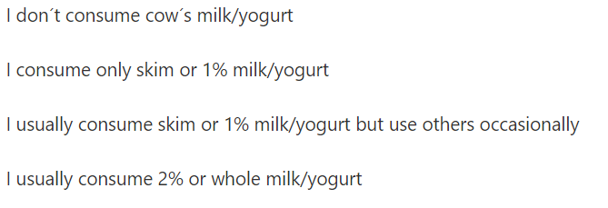
What type of milk/yogurt do you consume?

Slide 7
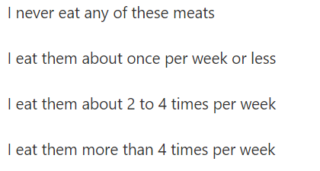
How often do you eat lean meat (lean beef, chicken, turkey, fish)?

Slide 8
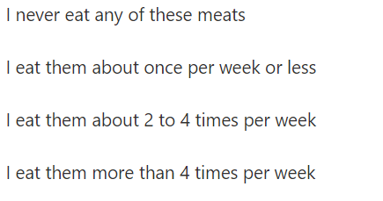
How often do you eat these types of meat: regular hamburger, bologna, salami, hot dogs, corned beef, spareribs, sausage, bacon, pastrami or liver?

Slide 9
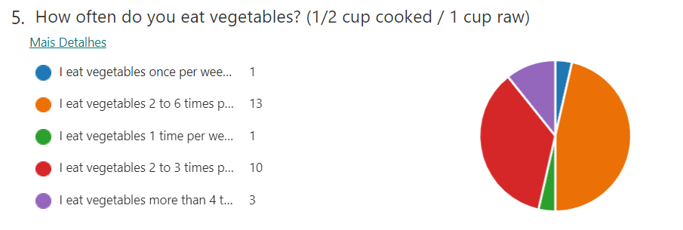
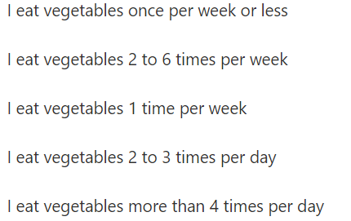
How often do you eat vegetables? (1/2 cup cooked / 1 cup raw)

Slide 10
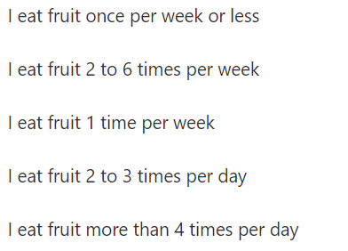
How often do you eat whole or canned fruit? (1 piece OR 1/2 cup canned)

Slide 11
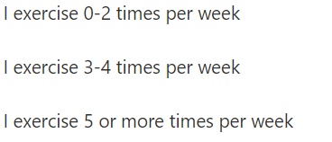
How often do you exercise?

Slide 12
What type of exercise do you usually do?

Slide 13
Conclusion …
We are not on the right highway for health…

